Slide 1
Irish Congress of Trade Unions (Northern Ireland)
Transatlantic Trade & Investment Partnership (TTIP) Seminar
26th January, 2015
Barry Finnegan (barry.finnegan@gcd.ie)
- Lecturer, Faculty of Journalism & Media Communications, Griffith College
- Member, ATTAC (Ireland) - Association for the Taxation of financial Transitions for the Aid of Citizens: https://www.facebook.com/AttacIreland
- ATTAC rep to, TTIP Information Network: www.TTIP.ie https://www.facebook.com/TTIPInformationNetwork

Slide 2
1. ISDS: anti-democratic, unacceptable, unreformable, unnecessary
2. TTIP: the economic growth myth
3. TTIP: the jobs myth
4. Workers’ Rights: an unnecessarily restrictive barrier to trade
5. Safety Last: eliminate the precautionary principle
6. Climate Change: ‘no change please, we’re corporate’
7. Buyer Beware: lack of food safety, unlabelled GMOs, cancerous cosmetics
7. And the Rest: financial regulation, impact on developing world, SOPA & PIPA are back (no digital privacy, eliminate net neutrality, education and health services, all public services
8. Resistance Is Fertile, and Global

Slide 3
#1: Investor-State Dispute Settlement (ISDS): undemocratic, unacceptable, unreformable, unnecessary
“ … allows companies to sue countries, but not vice versa, before a tribunal of for-profit arbitrators that is insulated from judicial review”
– Gus Van Harten, Associate Professor, Law School, York University, Ontario http://blog.oup.com/2014/01/van-harten-q-a-investor-state-arbitration/
- major transformation of both international and public law

Slide 4
- states delegate core powers of courts to private arbitrators
- conflicts with cherished principles of separation of powers, of judicial accountability and independence
- corporations bypass national courts
- all are equal before the law, but some are more equal than others

Slide 5
Example 2001:
Cosmetics billionaire Ralph Lauder (CME) V’s Czech Republic:
- ISDS ‘compensation’ $353m because of change to regulation of commercial TV licencing
- equal to annual Czech health-care budget
- adjusted (2012) as if was USA for population and size of economy (GDP) = $131 billion ($131,000,000,000)

Slide 6
Example 2013:
- Ruling by Ecuadorian court ordering Chevron to pay $19 billion to pay for their environmental destruction in Ecuador, overturned by IDSD
- Ecuadorian court was overruled under 1993 US-Ecuador treaty called ‘Encouragement And Reciprocal Protection Of Investments’ agreement

Slide 7
“When I wake up at night and think about arbitration, it never ceases to amaze me that sovereign states have agreed to investment arbitration at all.
1
… Three private individuals are entrusted with the power to review, without any restrictions or appeal procedure, all actions of the government, all decisions of the courts, and all laws and regulations emanating from parliament.
“ … Politicians have never given such authority to a national court, and no state has given an international court nearly so much power,”
- Arbitrator J. Fernández-Armesto, quoted in S. Perry, ‘Stockholm: Arbitrator and Counsel: The Double-hat Syndrome’, 7(2), Global Arbitration Rev (15 March 2013).

Slide 8
The Enlightened Question:
What specifically is it that the ‘investors’ and Commission employees conducting the TTIP negotiations find so unpalatable about the Irish, Northern Ireland and European justice system?
Would they like us to reform our commercial court for example? If so, specifically in what way?”
Where is the evidence of European and American judges riding roughshod over the interests of corporations and capitalists?

Slide 9
In the absence of a list of clearly identified problems with the Irish and European justice system, only one conclusion can be drawn:
=> ISDS is designed to allow companies to avoid the jurisprudence and constitutional rights which accompany the application of justice in democratic societies

Slide 10
European Commission’s “Public Consultation” & Ratification Process
- a marketing exercise, a perception management routine:
- “ … we need to reflect upon how to address the fact that EU countries already have 1,400 bilateral agreements of this kind, of which some date back to the 50s” - Trade Commissioner Malmström http://europa.eu/rapid/press-release_IP-15-3201_en.htm

Slide 11
- EU-Canada investment deal (CETA) , done deal, has ISDS- ‘can’t reopen the text’ http://trade.ec.europa.eu/doclib/docs/2013/november/tradoc_151918.pdf
- EU-Singapore Free Trade Agreement (EUSFTA), done deal, has ISDS; now checking “exclusive competence” at European Court of Justice (ECJ)

Slide 12
An “exclusive competence” deal means:
(a) no one has a right to change the text once the European Commission has signed off on it with the other party;
(b) 28 Member State Ministers for Trade at the EU Council of Ministers vote by Qualified Majority Vote (QMV), no one has a veto, no text changes;
(c) European Parliament simple majority vote, no text changes;
(d) no vote on text in Member State national parliaments, no text changes.

Slide 13
Commission says ‘TTIP is a “Mixed Agreement”
- if so, provide evidence, now
- explain the Commission’s legal opinion request to the ECJ that they agree EUSFTA is ‘mixed’
European People’s Party (EPP), biggest group in European Parliament (Fine Gael)
Pro-ISDS: “ … there are no clear indications on how to ensure the non-discrimination of EU investors in the US market. We have studied this issue with the commission and do not have any indication that this can be achieved without ISDS."

Slide 14
#2 TTIP Economic Growth Myth
- Trade Commissioner deGucht (Jan. 2014) only read the executive summary (second 1.46)
- Commission’s own research (CEPR study) paltry improvements in economic growth (0.03 to 0.054% per annum for each of ten years) = One twentieth (1/20th) of one percent economic growth per year
- report says 4/5 of trade displacement will take place through imports and exports within the same industry: job losses through that process are not counted

Slide 15
- ignores that one country’s export growth is another country’s export decline or reduction in domestic production
- €545 per family-of-four per annum TTIP windfall calculated by the assumed TTIP-induced profit created by removing costs of red tape (i.e. health and safety regulations), divided by total population, the multiplied by four:
- best-case scenario = €136 per person per year, or a cup of coffee: €2.62 per person per week!

Slide 16
#3: TTIP Jobs Myth
=========================
How many economists does it take to change a lightbulb?
None.
If the lightbulb was broken, the market would have fixed it!

Slide 17
Commission TTIP Study http://trade.ec.europa.eu/doclib/press/index.cfm?id=968
Poor Calculation Method:
‘Computable General Equilibrium’ (CEG) http://frankackerman.com/publications/trademodeling/Shrinking_Gains_Global_Trade_Liberalization.pdf
- regulations which protect workers, health, food quality and environment are “costs”
- removal of costs calculated as economic gain

Slide 18
- much evidence regulations create safe, stable, predictable working and investment conditions and boost economic growth are completely ignored
- financial gains to society, the state, companies and the economy flowing from regulations, are excluded from CGE method

Slide 19
- study predicts 0.6% EU jobs lost or displaced by 2027
- assumes a fixed labour-supply and perfect labour mobility, i.e. a 100% employment model
- e.g.: assumes steel jobs lost in France means French workers emigrate to new software engineer jobs in Romania, overnight, at no cost

Slide 20
- do not factor in the impact of human and social disruption
- assumes competitive, growing, economic sectors absorb job losses in other sectors
(evidence contradicts)
- do not factor in environmental and human health costs
(e.g.: use of previously banned chemicals, fracking-induced water pollution, weakened workers’ rights, GMO crop pollution and cross-pollination, etc)

Slide 21
‘The Transatlantic Trade & Investment Partnership: Implications for the European Union & Beyond’
- Jeronim Capaldo, Global Development & Environment Institute, Tufts University, predicts:
- net loses in terms of GDP
- EU will lose 600,000 jobs
- lose of working income per capita @ €4,800 Northern European: €4,200 UK workers. http://ase.tufts.edu/gdae/Pubs/wp/14-03CapaldoTTIP.pdf

Slide 22
#4: Workers’ Rights: are barrier to trade
=================================
Workers’ rights unnecessarily restrictive trade barriers
Least meddlesome regulations
ISDS ‘court’ decides meaning of “justifiable regulations … the public interest … least burdensome … fairness … equality …”
Minimum Wage: no US minimum wage
Workers’ Holidays: no statutory holidays in USA
The Veolia Case in Egypt

Slide 23
#5: Safety Last: eliminate the precautionary principle
=====================
Working Conditions - Health & Safety
- “regulatory harmonisation”
- “regulatory recognition”

Slide 24
We know capital moves to where pay, workers’ rights and workers’ conditions are lowest
As with NAFTA for US workers 1994, so with European workers with TTIP 2015
(and CETA & EUSFTA)
European factories will transfer production to USA

Slide 25
Commission wants to eliminate
‘precautionary principle’ e.g.: neonicotinoids
Reductions in bee populations across the world - a reduction which threatens 80% of the human food supply
EU used ‘precautionary principle’ to ban neonicotinoids

Slide 26
- CropLife America:
“Abuse of the precautionary principle by the EU. … Categorisation of chemicals as endocrine disruptors currently taking place” is “highly problematic”, and it “runs counter to the science-based risk assessment approach used by the US Environmental Protection Agency”.
- effects workers’ health and safety conditions, food safety and labelling, use of chemicals in production processes, cosmetics

Slide 27
#6: Climate Change: ‘no change please, we’re corporate’
- currently ISDS cases against Spain relate to solar panel regulations
- EU wants unrestricted access to US oil and fracked gas
- US wants to overturn French constitutional court ruling that government has right to ban fracking
- regulations and taxes to stop climate change will alter the investment environment and lead to ISDS compensation claims http://www.foeeurope.org/sites/default/files/publications/foee_ttip-isds-fracking-060314.pdf

Slide 28
The 1st Vattenfall case
Vattenfall I: Dispute Case (2009–2011) Regarding Environmental Regulations Applying to the Coal-Fired Power Plant Hamburg-Moorburg
2009, Vattenfall filed against Germany, sued for €1.4 billion, plus arbitration costs and interest

Slide 29
- first (known) investor-state arbitration procedure against Germany
- construction new coal-fired power plant in Hamburg-Moorburg, situated on the River Elbe
- Hamburg Environmental Authority issued licence imposing water quality standards
- Vattenfall said it made the whole investment project “unviable”
- argued the environmental permit violated the provisions set out in Part 3 of the Energy Charter Treaty regarding the promotion and protection of investments http://www.iisd.org/pdf/2012/german_nuclear_phase_out.pdf

Slide 30
#7. Buyer Beware: lack of food safety, cancerous cosmetics, unlabelled GMOs
==============================
Food Safety
- “mutual recognition”
- labelling (e.g.: contains allergens)
- food production to move from Europe to USA
- geographic names (Parma ham, Waterford bla, Red Leister, etc)
The Negative List if it is not on the list, it is not protected, and you cannot see the list)

Slide 31
Genetically Modified Food
- labelling & “substantial equivalence”
- Europe last place in world GMOs are not endemic
- seeds will not grow without use of patented herbicide and pesticide
- the seed from GMO crops belong to the corporation
- food production on island of Ireland: high quality, clean, green

Slide 32
Cancerous Cosmetics labelling for allergens
EU bans 1,328 chemicals and additionally regulates more than 250 ingredients
11 substances banned in USA http://www.beuc.eu/blog/325/

Slide 33
#7. And Everything Else:
====================
- EU wants to block new US financial regulations
- prospects for the poorest countries: raising regulations, workers’ rights and financial control

Slide 34
- SOPA & PIPA are back: circumvent Digital Privacy Laws
- eliminate net neutrality: ISPs to be allowed to charge for privilege of normal website speed,
- and slow everyone’s else’s website,
- not carry websites they do not like

Slide 35
- education and health services: all specific details not listed in the text for protection can be seen as up for open contract biding with only ‘cheapest’ criteria allowed
- all public services up for grabs

Slide 36
Extremist viewpoint reflected in EU-US
‘High Level Working Group on Jobs and Growth (HLWG)’
A stated objectives is:
“elimination, reduction, or prevention of unnecessary ‘behind the border’ non-tariff barriers to trade in all categories” http://www.ustr.gov/about-us/press-office/reports-and-publications/2013/final-report-us-eu-hlwg

Slide 37
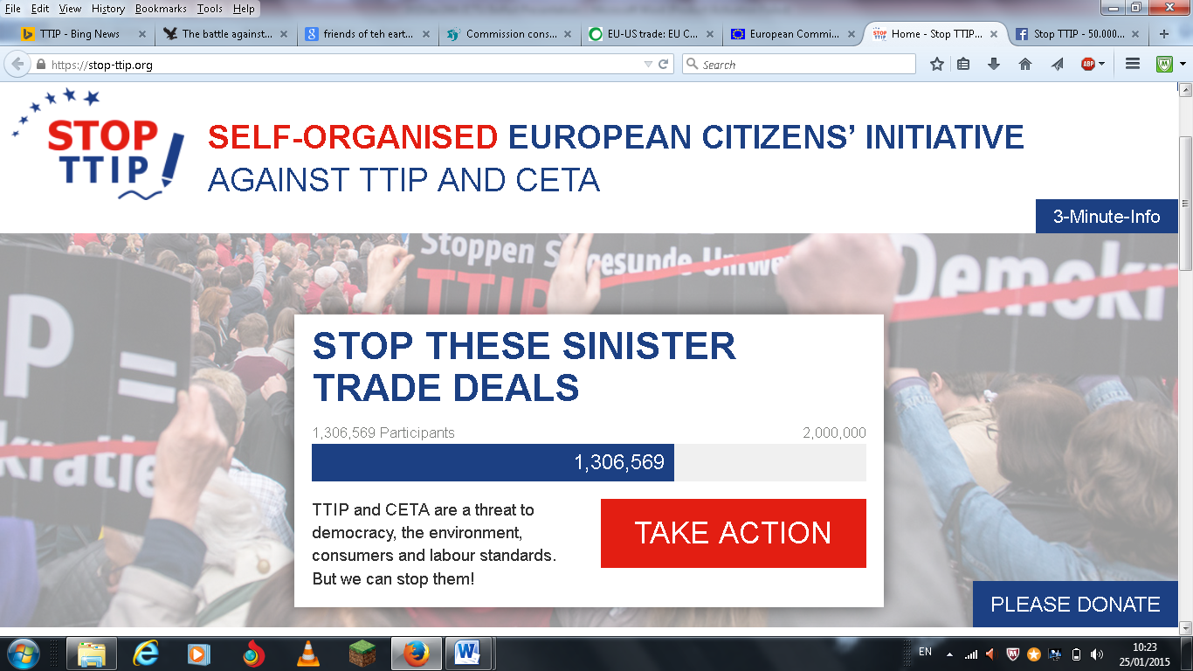
#8. Resistance Is Fertile, and Global
Trade Unions: - the key means of defeating the TTIP
- ICTU motion at congress
Civil Society: E.g.: Self-organised European Citizens’ Initiative against TTIP and CETA

Slide 38
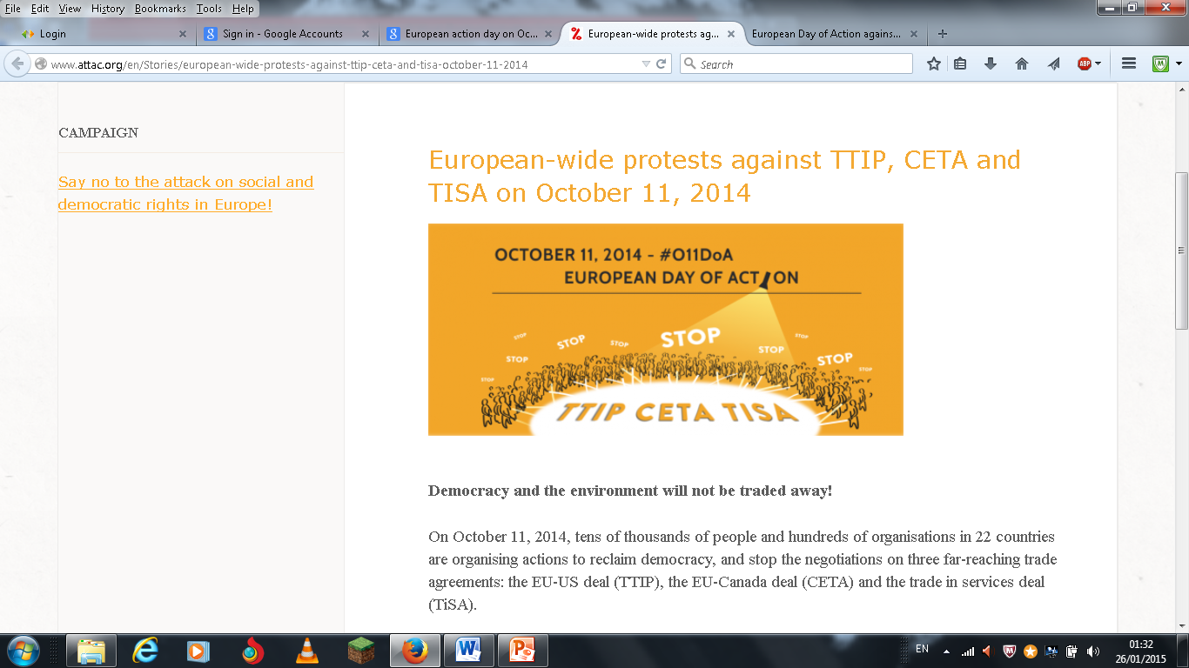

Slide 39
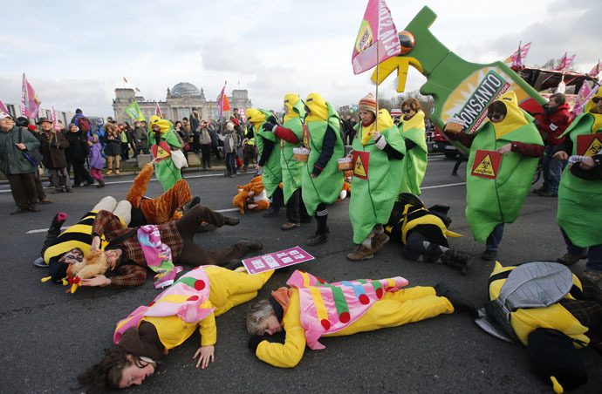
‘We are fed up!’:
50,000 march against TTIP & GMOs in Berlin, January 17, 2015

Slide 40
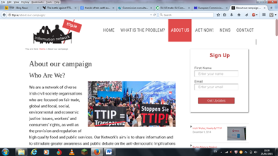
The TTIP Inform
TTIP Information Network:
ATTAC Ireland An Taisce Centre for Global Education
Comhlámh Trade Justice Group Debt & Development Coalition
Euro-Toques Ireland People’s Movement
Presentation Justice Network Trade Union Left Forum
Trócaire UNITE – The Union Young Friends of the Earth www.TTIP.ie https://www.facebook.com/TTIPInformationNetwork

Slide 41
3rd multi-sectoral European civil society strategy and campaigning meeting on TTIP
2nd-3rd February 2015 – Brussels
Hosted by
Seattle to Brussels Network - www.s2bnetwork.org
Rosa Luxemburg Foundation Brussels Office – www.rosalux-europa.info
Stopp TTIP – www.stop-ttip.org
European Attac Network – www.attac.org
EDRi – www.edri.org
German NGO Forum on Environment & Development - www.forumue.de
AK Europa - www.akeuropa.eu

Slide 42
With the support of:
Campaña No al Tratado Transatlántico de Comercio e Inversión (Spain) – www.noalttip.blogspot.com.es
Plataforma Não-ao-TTIP (Portugal) - www.nao-ao-ttip.pt
Coalition against secret (trade) deals (Slovenia)
Danish TTIP-network
Stop Tafta Luxembourg – www.stoptafta.lu
Stop TTIP Italia Campaign - www.stop-ttip-italia.net
TTIP stoppen" (Austria) - www.ttipstoppen.wordpress.com
TTIP-unfairhandelbar (Germany) - www.ttip-unfairhandelbar.de
Collectif national Stop TAFTA - Non au grand marché transatlantique (France) www.collectifstoptafta.org
No TTIP network Netherlands
TTIP Information Network (Ireland) - www.TTIP.ie

Slide 43
Global Day of Action, 18th April, Against Free Trade & Investment Regimes:
TTIP - Europe & America
CETA - Europe & Canada
EUSFTA - Europe & Singapore
TPP - America & Pacific Countries

Slide 44
The TTIP and the ISDS:
- Destroys democracy
- Privileges corporations
- Attacks workers rights
- Ensures climate change
- Blocks developing world
  Privatises public services
  Destroys the internet
People Power Will Defeat It!

